Slide 1

SOCIAL MEDIA USAGE ANALYSIS
KARMUKILAN D K

Slide 2
CONTENTS
SOCIAL MEDIA
ABOUT DATASET
INSIGHTS
CONCLUSION

Slide 3



Social Media
CREATING CONTENT SHARING THOUGHTS
More than 4.7 billion people around the world use social media.
Social media is also an increasingly important part of many companies marketing campaigns.
The largest social media platforms worldwide are Facebook, YouTube, WhatsApp, Instagram.

Slide 4
ABOUT DATASET
The dataset contains 100,000 entries.
It comprises 8 columns: 'UserID', 'Name', 'Gender', 'DOB' (Date of Birth), 'Interests', 'City', 'Country', and 'Age’.

Slide 5
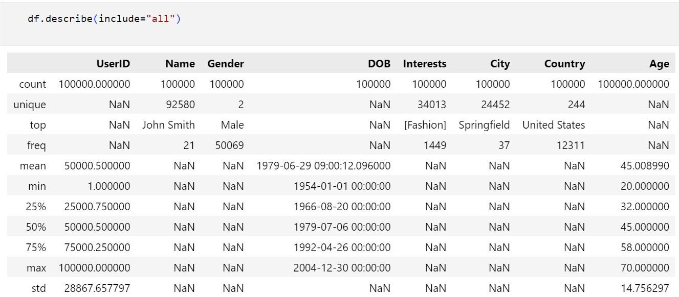
Statistical Insights

Slide 6
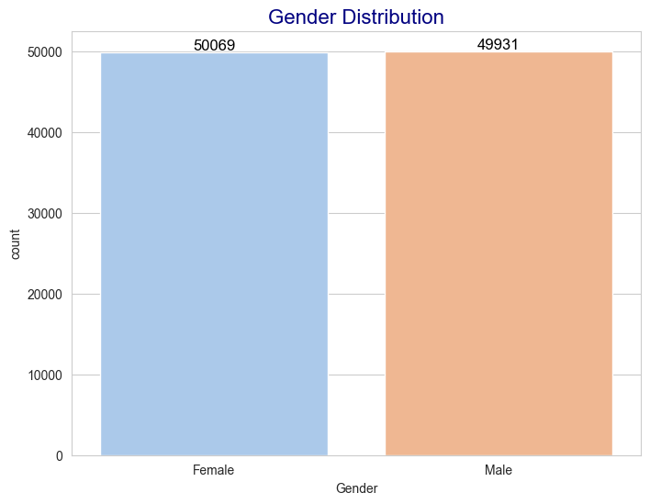
Gender Distribution

Slide 7
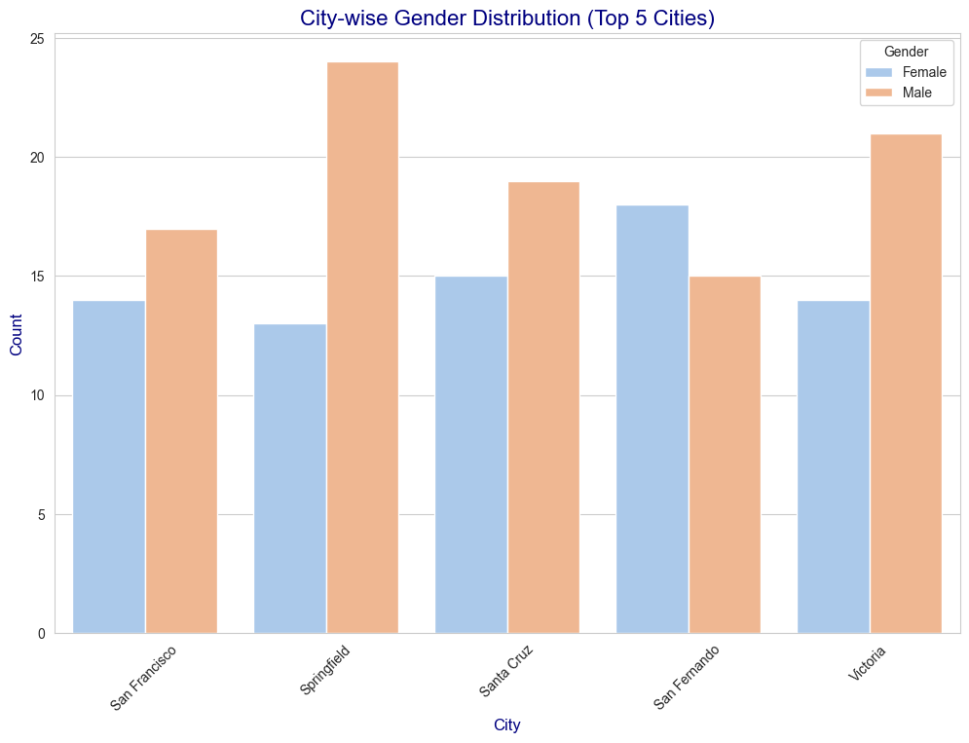
City wise top 5 Distributions

Slide 8
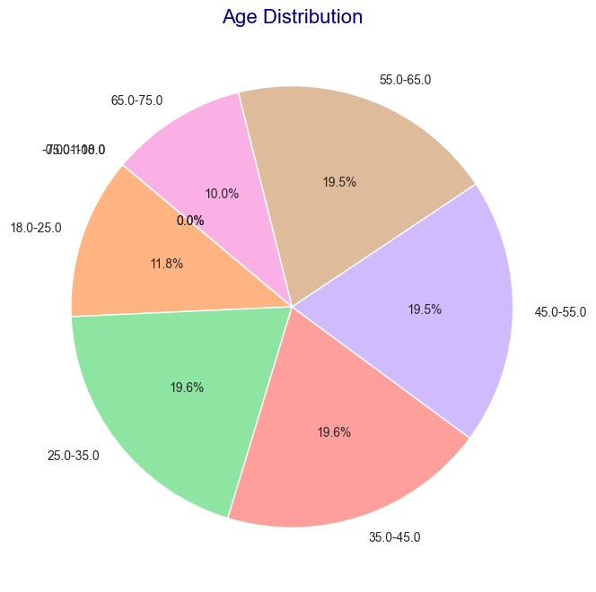
AGE DISTRIBUTION

Slide 9
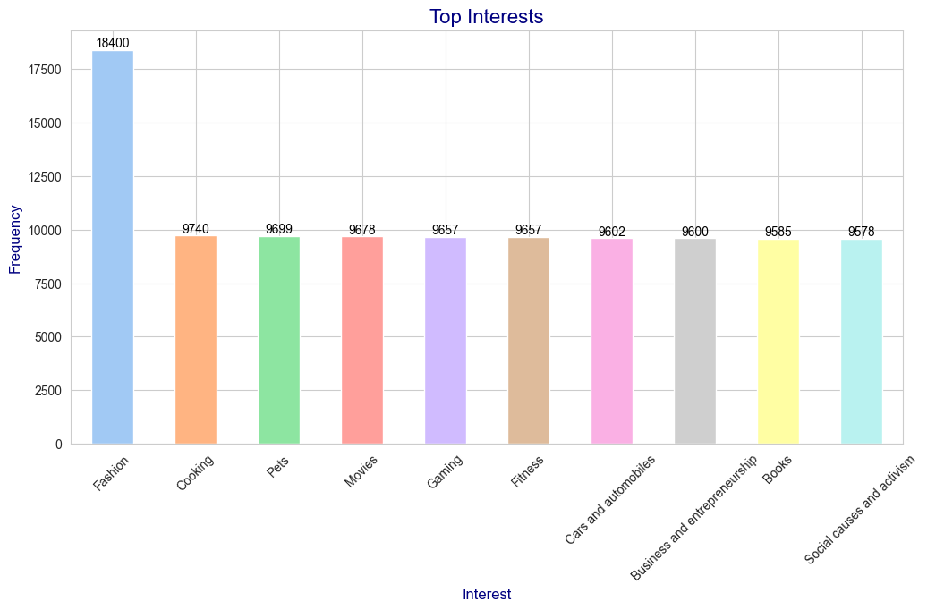
TOP INTEREST CATEGORY

Slide 10
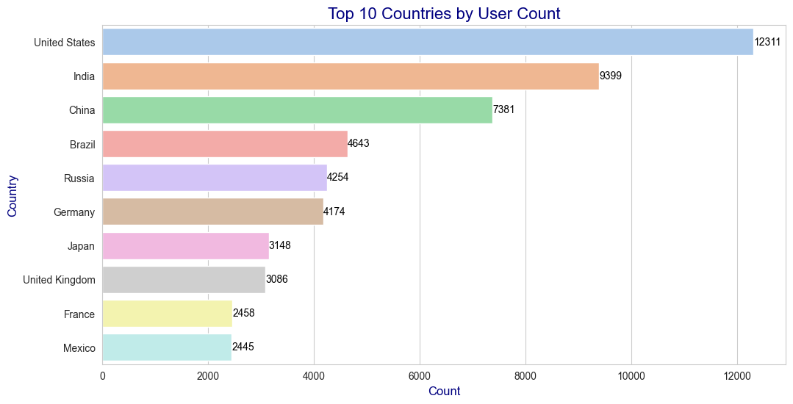
TOP 10 COUNTRIES

Slide 11
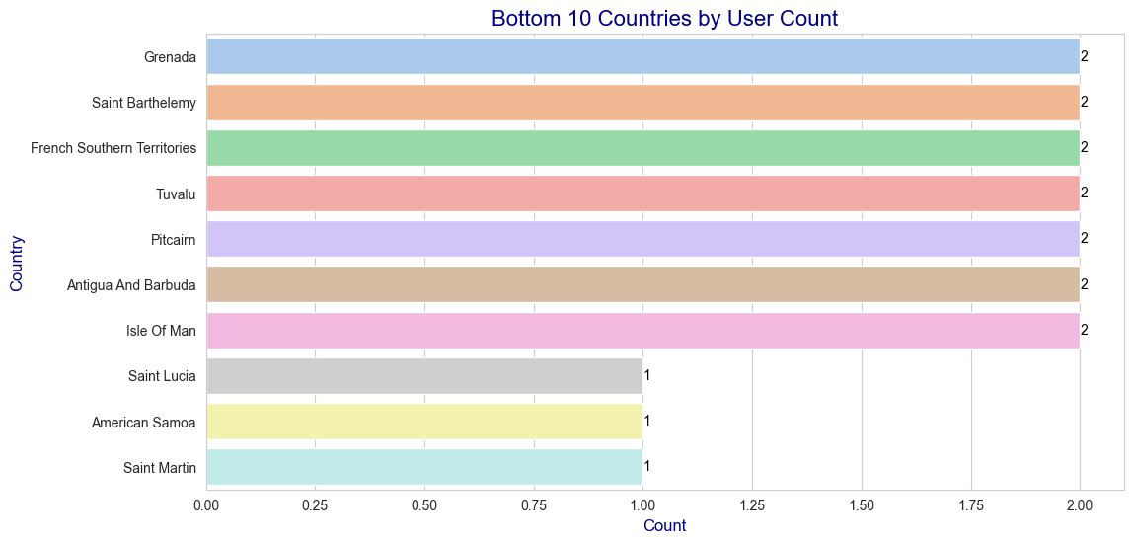
BOTTOM 10 COUNTRIES

Slide 12
CONCLUSION
Balanced Gender Distribution: The dataset shows an equal representation of male and female users, indicating gender diversity.
Geographical Focus: While predominantly from the United States, the dataset encompasses users from diverse cities and countries, offering some global representation.
Wide Age Range: Users span from 20 to 70 years old, with an average age of around 45, indicating a broad demographic coverage.
Diverse Interests: Users have varied interests, with 'Fashion' being the most common, suggesting a range of preferences among the user base.

Slide 13
THANK YOU !
KARMUKILAN D K

